Slide 1
SQL Part 2

Slide 2
Set Operators
A
B
UNION
A
B
INTERSECT
A
B
MINUS
Notes:
Set Operators
Set operators combine the results of two or more component queries into one result. Queries containing set operators are called compound queries.
All set operators have equal precedence. If a SQL statement contains multiple set operators, the Oracle server evaluates them from left (top) to right (bottom) if no parentheses explicitly specify another order. You should use parentheses to specify the order of evaluation explicitly in queries that use the INTERSECT operator with other set operators.

Slide 3
UNION Operator
A
B
The UNION operator returns results from both queries after eliminating duplications.
Notes:
UNION Operator
The UNION operator returns all rows that are selected by either query. Use the UNION operator to return all rows from multiple tables and eliminate any duplicate rows.
Guidelines
The number of columns and the data types of the columns being selected must be identical in all the SELECT statements used in the query. The names of the columns need not be identical.
UNION operates over all of the columns being selected.
NULL values are not ignored during duplicate checking.
The IN operator has a higher precedence than the UNION operator.
By default, the output is sorted in ascending order of the first column of the SELECT clause.

Slide 4

UNION
Ex: List the name and phone number of all adopters and volunteers.
Adopters name and number
Volunteers name and number

Slide 5
2 queries must be union-compatible
This means they have the same number of columns…
and the corresponding data types are compatible

Slide 6
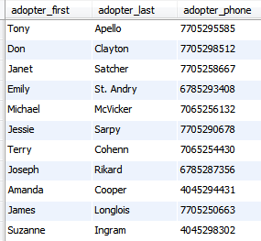
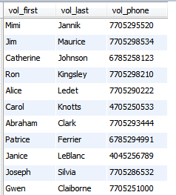
Column 1
First names
Column 2
Last Names
Column 3
Phone numbers

Slide 7
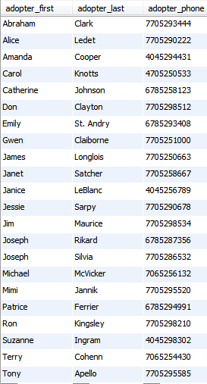
SELECT adopter_first, adopter_last, adopter_phone
FROM adopter
UNION
SELECT vol_first, vol_last, vol_phone
FROM volunteer
ORDER BY 1;
Column headings come from the first query

Slide 8
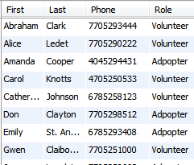
SELECT adopter_first AS First, adopter_last AS Last, adopter_phone AS Phone, ‘Adopter’ AS Role
FROM adopter
UNION
SELECT vol_first, vol_last, vol_phone, ‘Volunteer’
FROM volunteer
ORDER BY 1;
The person’s Role is listed (Adopter or Volunteer)

Slide 9
Data Manipulation Language (DML) for SQL:
INSERT
UPDATE
DELETE

Slide 10
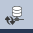
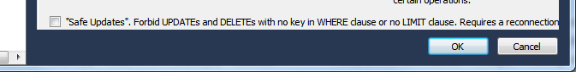
In MySQL: SAVE YOUR WORK!!!! Go to Edit | Preferences | SQL Editor, and un-check “Safe Updates” at the bottom of the screen. Click OK
Then click: Database | Connect to Database | OK

Slide 11
Syntax of INSERT statement:
INSERT INTO table (column1, column2, …)
VALUES (value1, value2, …);
Example:
INSERT INTO Part (PartID, Descr, Qty, Class, Warehouse, Price)
VALUES ('LM83', 'Stove', 35, 'AP', 3, 625);

Slide 12
Example of INSERT statement:
INSERT INTO Part (PartID, Descr, Qty, Class, Warehse, Price)
VALUES ('LM83', 'Stove', 35, 'AP', 3, 625);

Slide 13
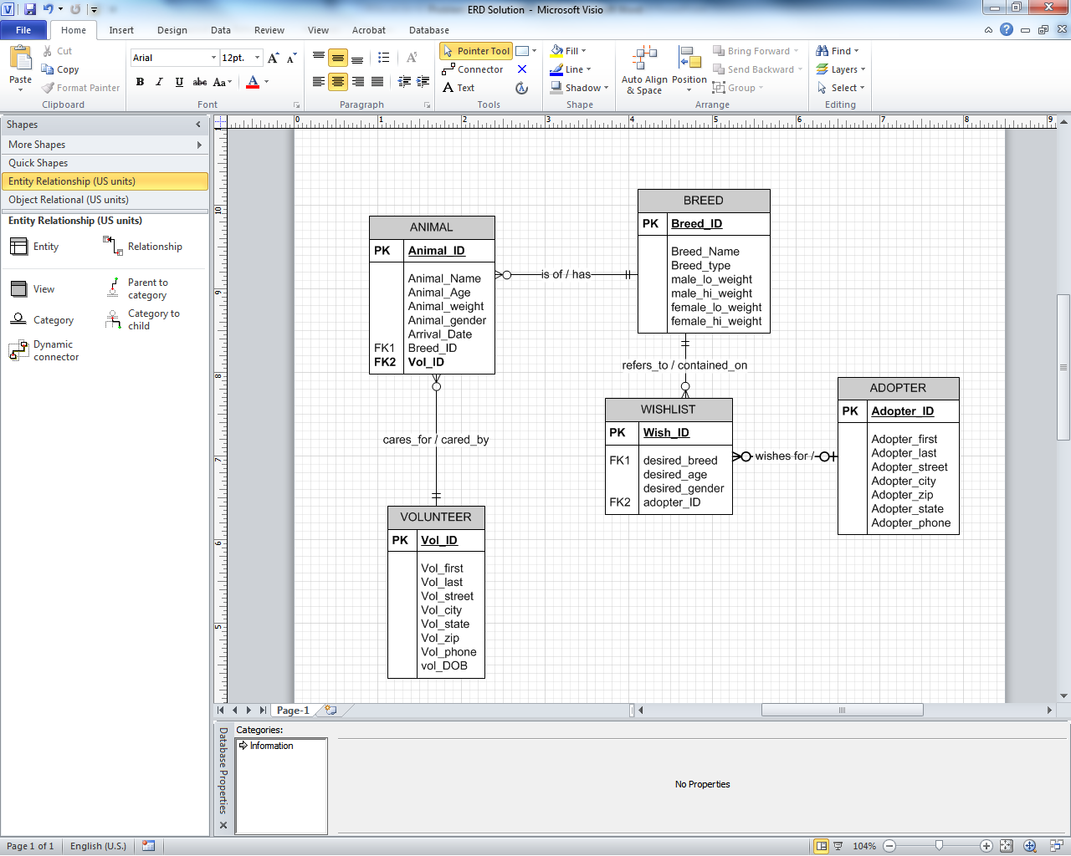
Insert a new record into Wishlist
Terry Cohenn wishes for a 1 year
Old Female Border Collie
INSERT INTO wishlist (Wish_ID, desired_breed, desired_age,
desired_gender, Adopter_id) VALUES ( 19, 12, 1, ‘f’, 35 );

Slide 14
Syntax of UPDATE statement:
UPDATE table
SET column = new_value
[WHERE criteria];
UPDATE adopter SET adopter_zip = 30022 WHERE adopter_city = ‘Columbus’;

Slide 15
Syntax of DELETE statement:
DELETE FROM table
[WHERE criteria];
DELETE FROM Wishlist
WHERE adopter_id = 21;

Slide 16
SQL, Part II Homework:
See SQL 2 Homework in D2L

